Slide 1
CSCI 631 Foundations of Computer Vision
Ifeoma Nwogu
ion@cs.rit.edu
Artificial Neural Networks

Slide 2
Logistic regression unit (or perceptron or single neuron)
x₁
w₁
Weights
x₂
Input
w₂
Output: sgn(w⋅x + b)
x₃
w₃
.
.
.
w_{D}
Can incorporate bias as component of the weight vector by always including a feature with value set to 1
x_{D}

Slide 3
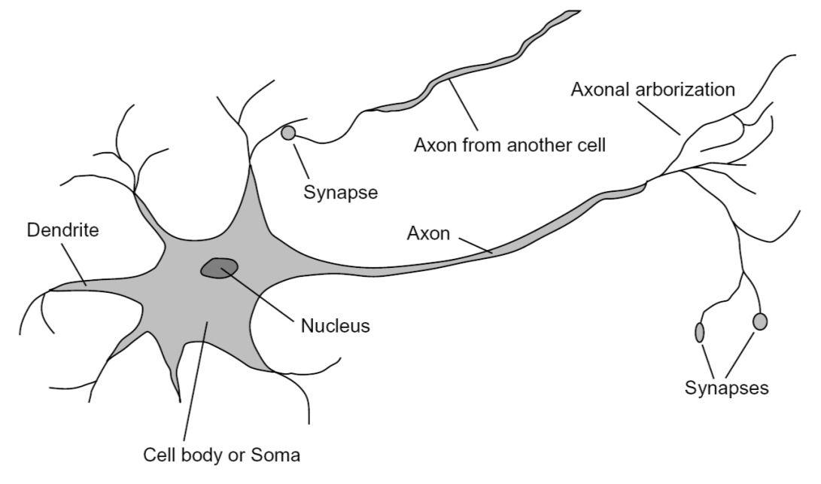
Loose inspiration: Human neurons
Notes:
From Wikipedia: At the majority of synapses, signals are sent from the axon of one neuron to a dendrite of another... All neurons are electrically excitable, maintaining voltage gradients across their membranes… If the voltage changes by a large enough amount, an all-or-none electrochemical pulse called an action potential is generated, which travels rapidly along the cell's axon, and activates synaptic connections with other cells when it arrives.

Slide 4
From LR to neural networks
Hidden
More complex architecture
a network of neurons
NN have 1+ hidden layers
Every node in one layer is connected to every node in the next layer
There can be one or more output nodes
Input
Output

Slide 5
Nonlinear activation functions
Sigmoid(x) =
Tanh(x) =
ReLU(x) =
ReLU work extremely well for problems in vision

Slide 6
Multi-class classification
K classes => k output nodes
K-output vector
Targets are represented as an indicator matrix
Unlike binary classification, no rounding with softmax
Labels are 0,1,2,3…
Softmax outputs probabilities between 0 and 1
K Classes

Slide 7
Categorization of softmax outputs
Notes:
Labels have no numerical meanings! Label 1 Is not closer to label 2, they are just distinct symbolls

Slide 8
Softmax outputs continued
Predictions look like
[0.1, 0.2, 0.4, 0.1, 0.2]
assume probability of target is highest
Target labels look like:
[0, 0, 1, 0, 0]; target class label is 2
PREDICTIONS
TARGETS

Slide 9
From binary to multiclass classification
From:
Input = array of 48*48 pixels; Output = +ve/-ve face
To:
Input = array of 48*48 pixels; Output = happy, sad, angry, surprised, disgusted, afraid, neutral
Other examples…? MNIST?

Slide 10
Beyond logistic regression (multiclass)
For a binary class
We only need one output node to represent the probability of the class we are interested in
If P(Y=1|X); then P(Y=0|X) = 1 - P(Y=1|X)
Alternatively, we could introduce 2 output nodes so that:
y₁
w₁
x₁
*
x₂
y₂
*
w₂

Slide 11
Beyond logistic regression (multiclass)
P(Y=1|X) =
P(Y=2|X) =
These sum to 1

Slide 12
Beyond logistic regression (multiclass)
Extending this notion to k classes
P(Y=m|X) =
This classifier is known as Softmax classifier

Slide 13
Softmax cross-entropy function
Can we derive the previous function from this general form?

Slide 14
Feedforward
w
z₁
v
x₁
How predictions are made:
Inputs are fed into the blue nodes and
multiplied by the weights connecting blue
to red nodes giving w^{T}x
In the red nodes, a nonlinear activation function is applied to w^{T}x, yielding new values z.
These results z act as the input to the next layer and are multiplied by the green weights giving v^{T}z
This process is continued for as many layers as there are
Finally, softmax is applied at the last layer (for classification)
z₂
y₁
x₂
z₃
y₂
x₃
z₄

Slide 15
Symbols
X is the input data matrix having N rows and D cols
N = number of data samples available
D = number of dimensions or features for each sample
Y is the predicted output matrix having N rows and k cols (for a k-classification problem)
For binary classification, Y is Nx1
T is a target value, also N x k (or Nx1)

Slide 16
Symbols cont’d
J is the cost/loss/error function
We want to minimize the cost function
L is the likelihood function P(data|params)
We want to maximize the likelihood (-ve J)
l is the log likelihood (log L)
We often maximize the log likelihood instead

Slide 17
Backpropagation
w
z₁
v
x₁
z₂
y₁
How neural network weights are learned:
Errors are propagated backwards
starting from the last layer
Green weights V depend on the errors at the
output (between the targets and predictions) - softmax
Red weights W depend on the errors at the red hidden nodes – gradient descent
The pattern continues backwards for as many layers as there are…
Weights are updated based on propagated errors
x₂
z₃
y₂
x₃
z₄

Slide 18
Pseudocode for NN (feedforward)
Assign all network inputs and output
Initialize all weights with small random numbers between -1 and 1
while ((max_num_iter < spec_iters) AND (curr_err is > spec_err))
do //one epoch
for every data point in the training set
Present the point as input to the network
//Propagate input forward through the network:
for each layer in the network
for every node in the layer
1. Calculate weighted sum of the inputs to the node
2. Add the bias to the sum
3. Calculate the activation for the node
end
end

Slide 19
Pseudocode for NN (backprop)
//Propagate the errors backward through the network
for every node in the output layer
calculate the error signal
end
for all hidden layers
for every node in the layer
1. Calculate the derivatives at the node (wts and biases)
2. Update each node's weight in the network
end
end
//Calculate Global Error
Calculate the Error Function
end // for every data point
end /while…do

Slide 20
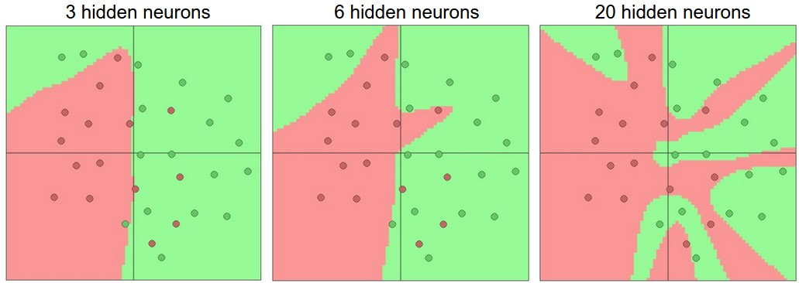
Neural Networks
Can represent nonlinear functions (when built from composition of logistic regression units or neurons)
Source: http://cs231n.github.io/neural-networks-1/

Slide 21
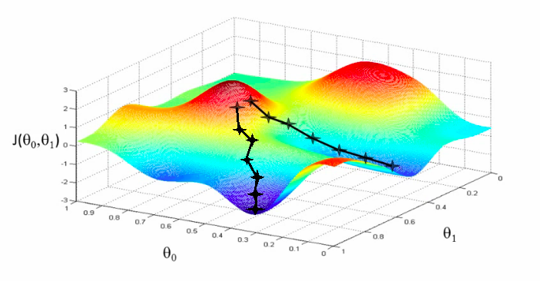
Training of multi-layer networks
Find network weights to minimize the error between true and estimated labels of training examples:
Update weights by gradient descent:
w₂
w₁

Slide 22
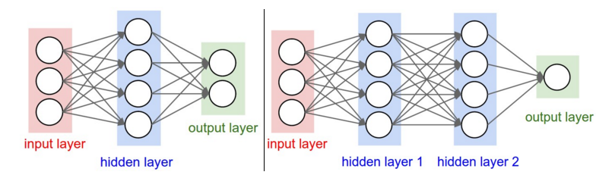
Multi-Layer Neural Networks
Beyond a single hidden layer:
Figure source: http://cs231n.github.io/neural-networks-1/

Slide 23
Training of multi-layer networks
Find network weights to minimize the error between true and estimated labels of training examples:
Update weights by gradient descent:
Back-propagation: gradients are computed in the direction from output to input layers and combined using chain rule
Stochastic gradient descent: compute the weight update w.r.t. one training example (or a small batch of examples) at a time, cycle through training examples in random order in multiple epochs

Slide 24
Choosing activation functions
The last layer activation function depends on your problem – regression/classification
Softmax
The activation function of hidden layers is more interesting:
Sigmoid not good for v deep networks; vanishing gradients; get very small with recursion
ReLu nice for vision problems, but in other cases can cause a “dead neuron”

Slide 25
Choosing activation functions
Which has stronger gradient values?
Between –1 and +1, the derivative of the tanh exists between 0.42 and 1
Between 0 and 1, the derivative of the sigmoid exisits between 0.20 and 0.25

Slide 26
Neural networks: Pros and cons
Pros
Flexible and general function approximation framework
Can build extremely powerful models by adding more layers
Cons
Hard to analyze theoretically (e.g., training is prone to local optima)
Huge amount of training data, computing power may be required to get good performance
The space of implementation choices is huge (network architectures, parameters)

Slide 27
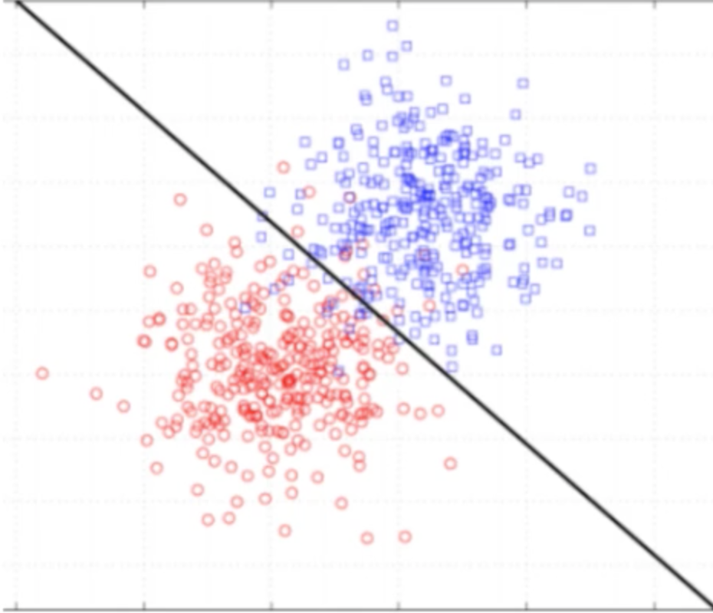
Regularization and overfitting
Major problem with our cost function
Ideal weights are infinite!
Given the data distribution below:
Solved weights are:
[0, 4, 4]
[w₀, w₁, w₂]
Equation of this line?

Slide 28
Ideal solution = infinite weights!
Taking a test point x₁=1, x₂ = 1 with label t₁ = 1;
If weights = [0,1,1] then,
𝛔(w₀+ w₁x₁+ w₂x₂) = 𝛔 (2) = 0.88080
y = 0.88080 => J = 0.126928
If weights = [0,4,4] then,
𝛔(w₀+ w₁x₁+ w₂x₂) = 𝛔 (8) = 0.99966
y = 0.99966 => J = 0.00034

Slide 29
Ideal solution = infinite weights!
If weights = [0,10,10] then,
𝛔(w₀+ w₁x₁+ w₂x₂) = 𝛔 (20) = 0.9999
y = 0.9999 => J = 2.0611 x 10⁻⁹
Ideal weights = [0, ∞, ∞]
When we have disproportionately large weights, the network starts to overfit.

Slide 30
Regularization – L2
Regularization penalizes very large weight!
We accomplish this by adding a penalty function to our initial cost function
𝛌 is a smoothing parameter usually between 0.1 and 1, but is data dependent
Penalty function

Slide 31
Solving for w from J_{reg}
Gradient descent is now not
The original derivative is not affected by the addition, so we just differentiate the penalty and add

Slide 32
L2 regularized gradient decent update
In matrix form,

Slide 33
L1 regularization
Skinny X
D <<N
Fat X
D>N
Goal:
to select a small number of features that predict the trend
remove features that are noise
Induce “sparsity” where many weights = 0

Slide 34
L1 regularization continued
Similar to L2, just add a penalty term

Slide 35
L1 regularized gradient decent update
In matrix form,
𝛌 here is less restrictive in the values it takes

Slide 36
Summary
Both L1 and L2 prevent overfitting to noise
L1 selects the most important features and induces sparsity (setting other wts to zero)
L2 ensures that none of the weights are disproportionately large
Both L1 and L2 improve generalization on never-been-seen-before data

Slide 37
Elastic Net Regularization
Elastic net is when both L1 and L2 regularizations are combined simultaneously

Slide 38
Adam Optimizer
Adam is a popular algorithm in the field of deep learning because it achieves good results fast
A more efficient alternative to SGD
Maintains a per-parameter learning rate that improves performance on problems with sparse gradients (e.g. natural language and computer vision problems)

Slide 39

Questions

